Slide 1


FIFA 2018/2019 PLAYER COMPARISON ETL PROJECT

Slide 2
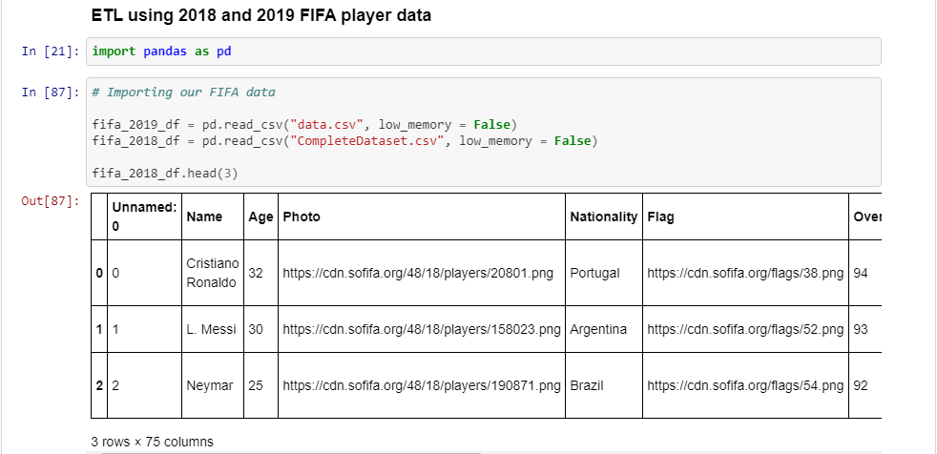
Project analysis slide 11
EXTRACTION
We received a request to compare player statistics from 2018 to 2019. We found two CSV files in Kaggle that contain this data and we imported the CSV files into python and read it with pandas. This allowed us to create data frames that we can now manipulate to get the data we are looking for.

Slide 3





Project analysis slide 3
TRANSFORM
REORGANIZE COLUMNS AND REMOVE DUPLICATES
CONVERT EUROS TO DOLLARS FOR WAGE AND VALUE
MAKE A TABLE OF ATTACKING PLAYERS AND THEIR STATISTICS
DROP COLUMNS
JOIN DATA ON PLAYER ID

Slide 4
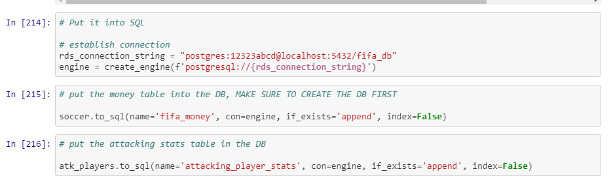
Project analysis slide 11
LOAD
We loaded the data into SQL because SQL is widely utilized by our company and will allow all employees to easily access the data.

Slide 5
Thank You

